Slide 1
Manholes Monitoring System

Slide 2




Our team
Tanvir Ahmed
Sourav Hazra
Sihab Mahmud
Sujoy Mitra
ID:19202103424
ID:19202103036
ID:19202103032
ID:19202103407
Supervised by
Md. Anwar Hussen Wadud

Slide 3
Table of contents
01
02
03
04
Theory
System Design
We can describe the topic of the section here
We can describe the topic of System Design here
Feasibility Study
Process & Future Work
We can describe the topic of Feasibility Study here

Slide 4
01
Theory

Slide 5
Introduction
A manhole monitoring system uses sensors and technology to remotely monitor the conditions inside and around manholes. The system detects and alerts about potential hazards such as water level, gas leaks, temperature changes, or unauthorized access.
The collected data is transmitted to a central monitoring station to improve safety and efficiency while reducing the need for manual inspections and maintenance.

Slide 6
Objective
The objective of a manhole monitoring system is to enhance safety, efficiency, and cost-effectiveness in managing manholes.
The system aims to detect and alert about potential hazards, reduce the need for manual inspections, and ensure the safety of workers and the public.

Slide 7
Features
*Real-time Monitoring
*Automatic Alerting
*Remote Access
*Historical Data Analysis
*Low Cost and Easy Installation

Slide 8
Why Chosen
A manhole monitoring system project can provide numerous benefits, including improved safety, reliability, efficiency, and cost-effectiveness in managing manholes.
The system can offer real-time monitoring and alerts, reduce the need for manual inspections and maintenance, and improve overall infrastructure management and optimization.

Slide 9
02
System Design

Slide 10
ER diagram
An Entity-Relationship Diagram (ERD) is a visual representation of entities and their relationships..

Slide 11
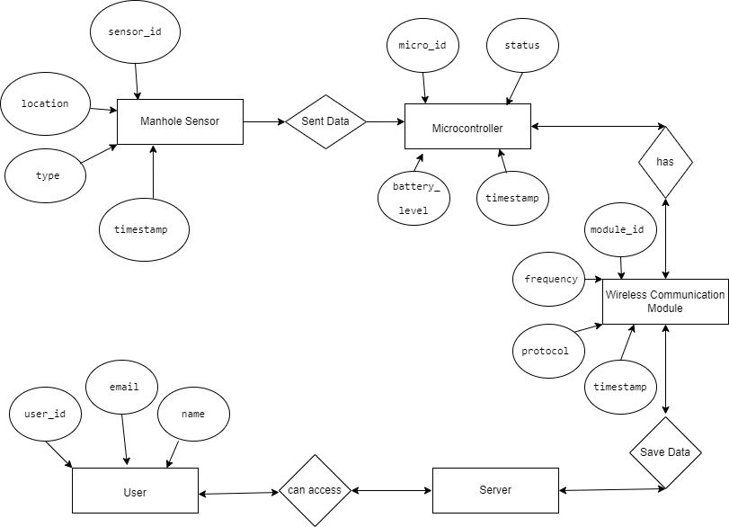
Proposed System:

Slide 12
03
Feasibility Study

Slide 13
Feasibility
Technical Feasibility
The proposed Manhole Monitoring System appears to be technically feasible, as it utilizes well-established IoT technologies such as advanced sensors, wireless communication, and cloud-based platforms. The system is designed to provide reliable and real-time monitoring of manholes, enabling prompt detection of potential issues and the implementation of appropriate measures.

Slide 14
Cost Feasibility
Hardware Costs:
sensors, microcontrollers, wireless communication modules, and power supplies.
Installation and Maintenance Costs
Software Costs:
Developing software for the system requires expertise in programming languages and experience with IoT platforms.
The cost of installation and maintenance can be higher for the IoT-based system, especially if the system is installed in remote or inaccessible areas

Slide 15
04
Process & Future Work

Slide 16
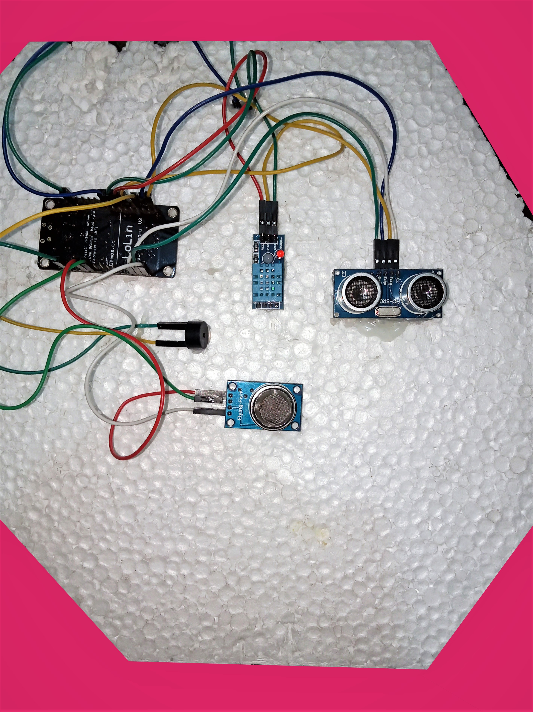
List of Equipments
NodeMCU
DHT11 Ultrasonic sensor
Gas sensors Buzzer Led

Slide 17
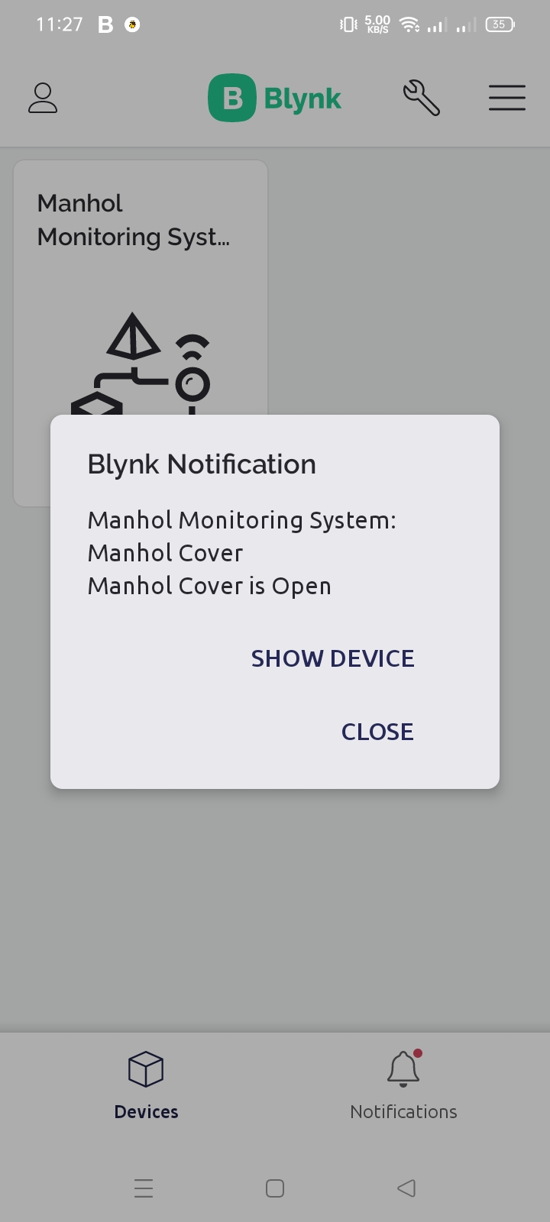
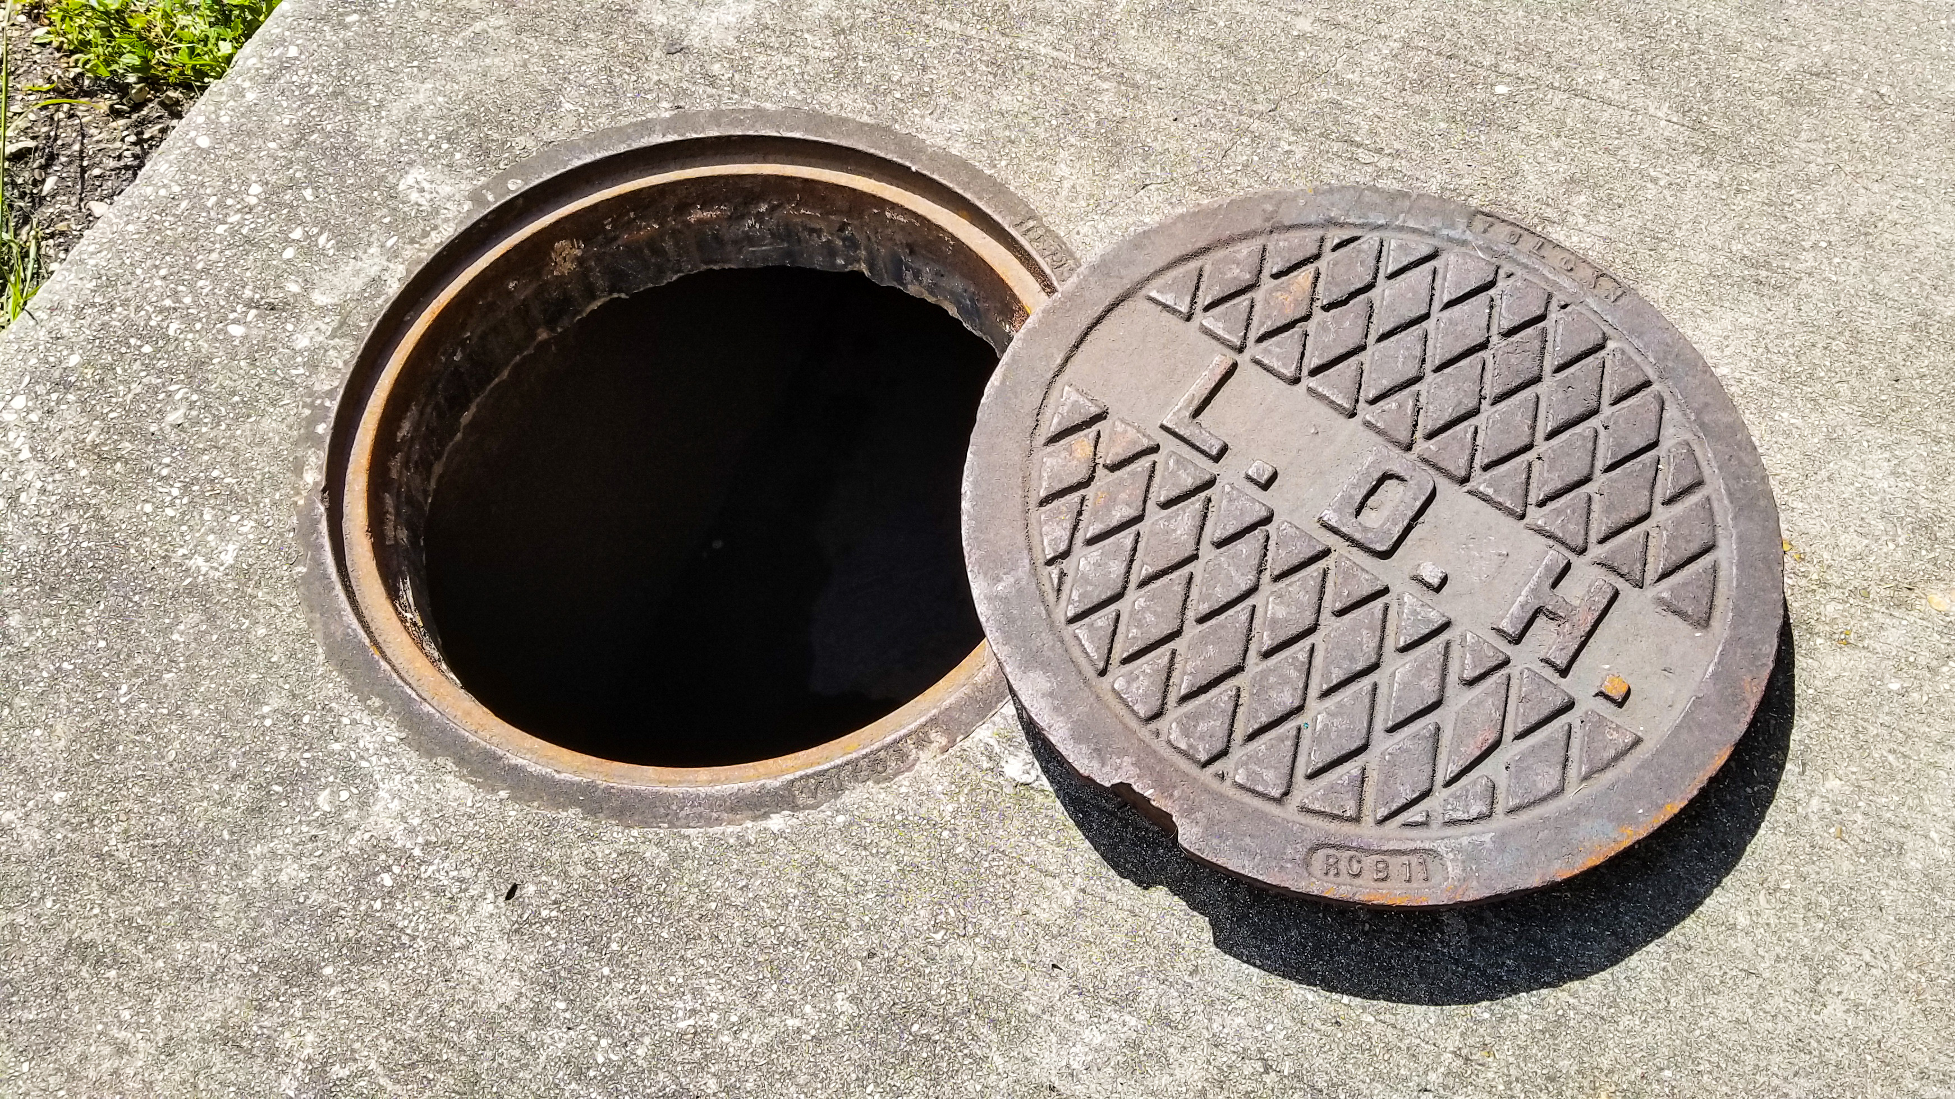

When Manhole Cover is opened

Slide 18
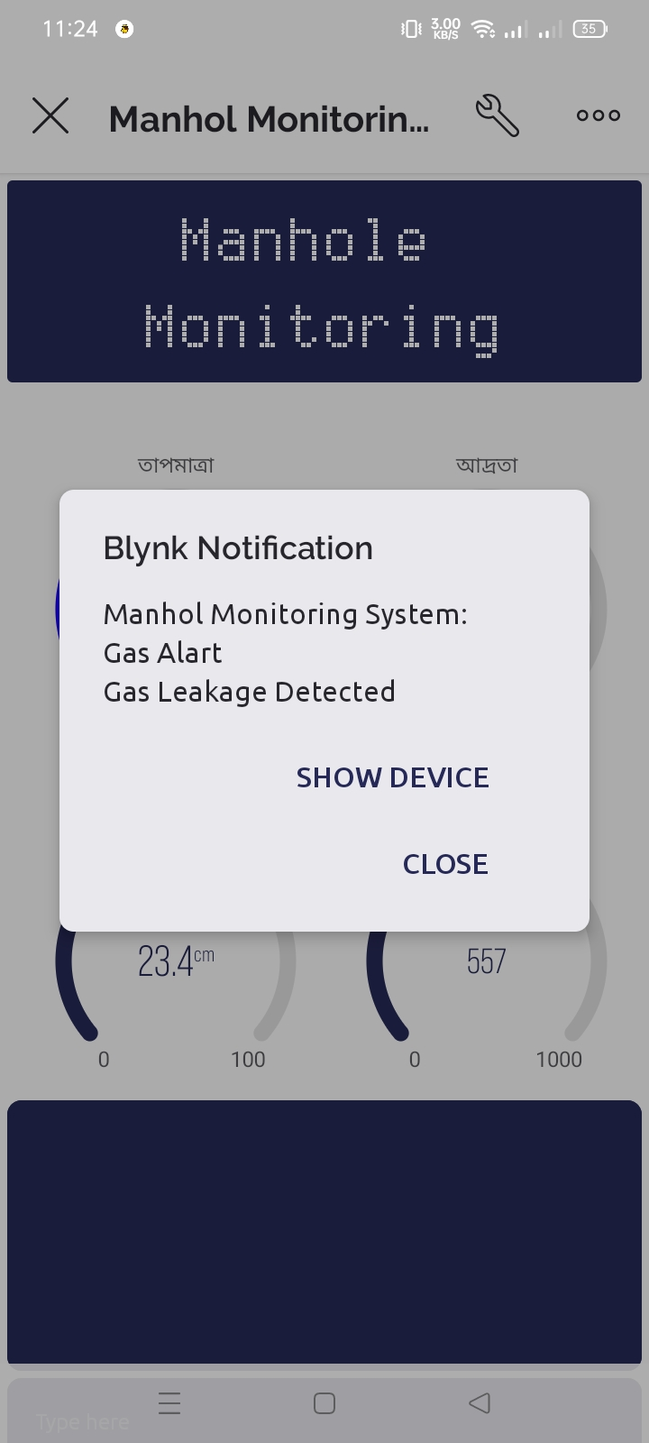
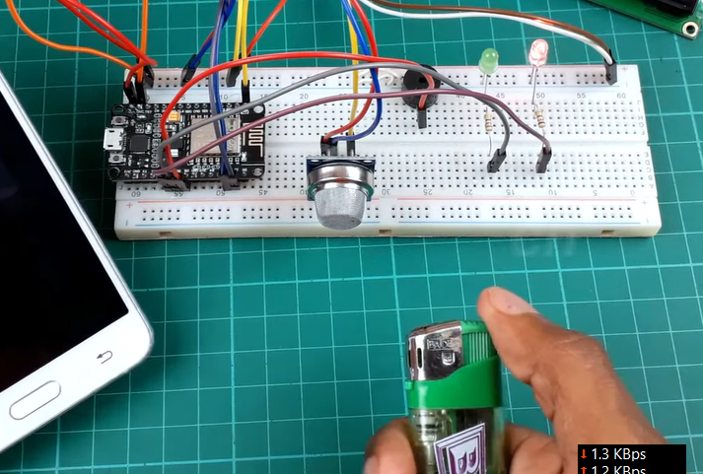

Gas Detection

Slide 19
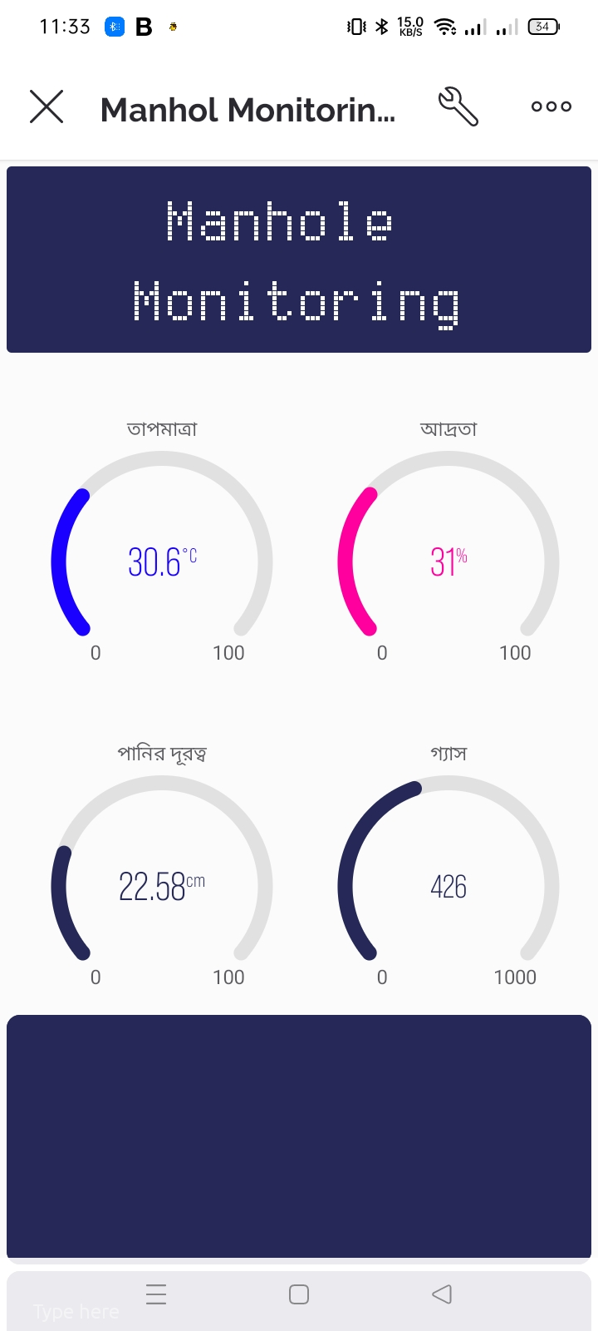
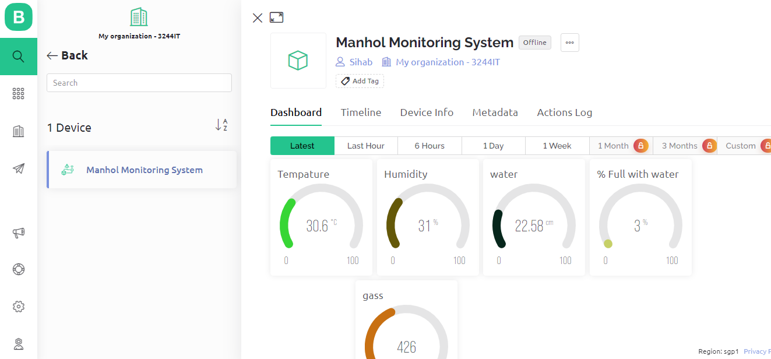
User Interface(UI)

Slide 20
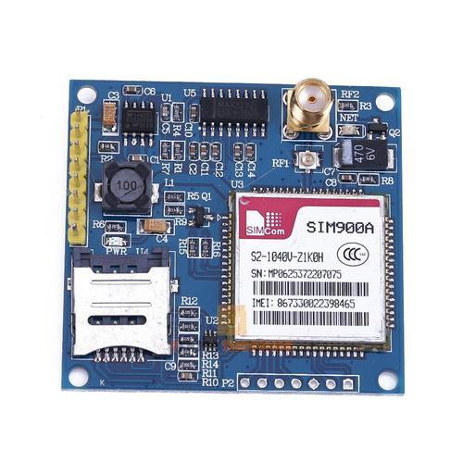
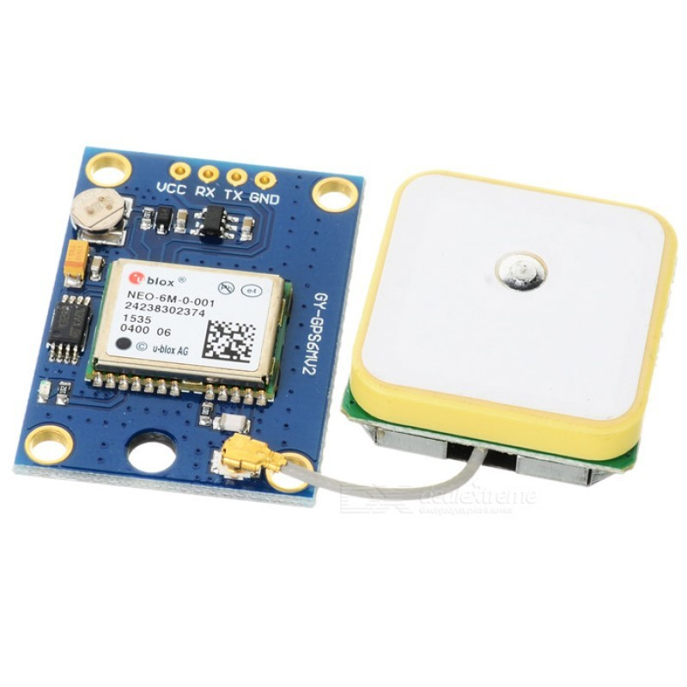
Future Work
Wireless Module
GPS Module

Slide 21

Thanks!
Does anyone have any questions?

